Slide 1
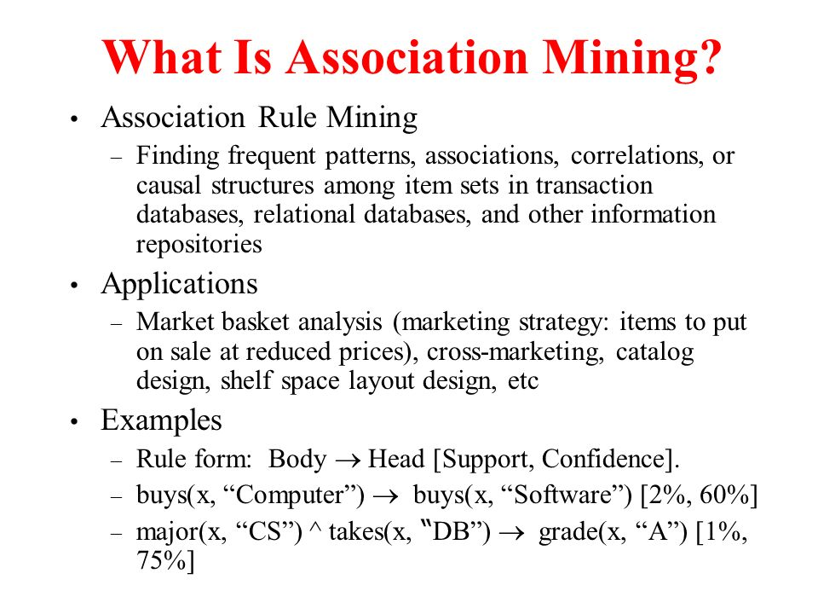

Slide 2
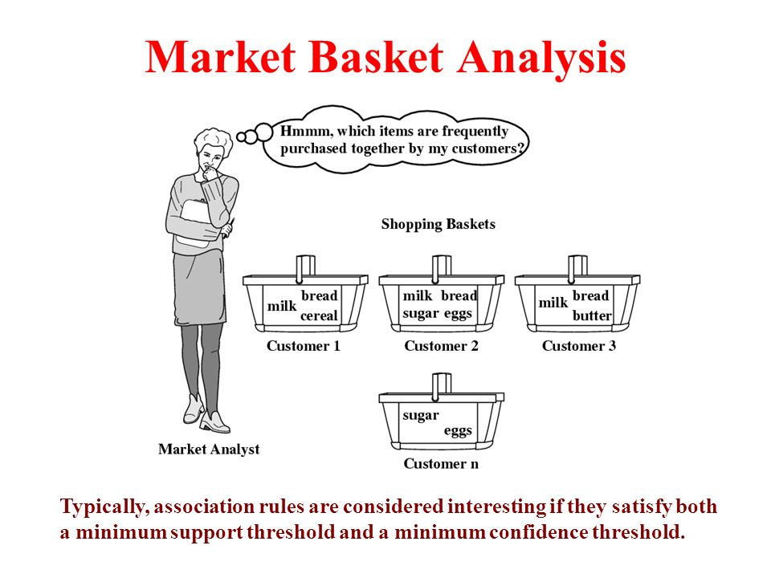

Slide 3
Assocaition Rule Mining
Data Mining Task
Find frequent itemset
Find interesting association or correlation relationship between a large set of data item.
Rule based association learning method

Slide 4
Association Rule Mining
Given a set of transactions, find rules that will predict the occurrence of an item based on the occurrences of other items in the transaction
Market-Basket transactions
Example of Association Rules
{Diaper} → {Beer}, {Milk, Bread} → {Eggs,Coke}, {Beer, Bread} → {Milk},
Implication means co-occurrence, not causality!

Slide 5
Definition: Frequent Itemset
Itemset
A collection of one or more items
Example: {Milk, Bread, Diaper}
k-itemset
An itemset that contains k items
Support count (σ)
Frequency of occurrence of an itemset
E.g. σ({Milk, Bread,Diaper}) = 2
Support
Fraction of transactions that contain an itemset
E.g. s({Milk, Bread, Diaper}) = 2/5
Frequent Itemset
An itemset whose support is greater than or equal to a minsup threshold

Slide 6
Definition: Association Rule
Association Rule
An implication expression of the form X → Y, where X and Y are itemsets
Example: {Milk, Diaper} → {Beer}
Rule Evaluation Metrics
Support (s)
Fraction of transactions that contain both X and Y
Confidence (c)
Measures how often items in Y appear in transactions that contain X
Example:

Slide 7
Association Rule Mining Task
Given a set of transactions T, the goal of association rule mining is to find all rules having
support ≥ minsup threshold
confidence ≥ minconf threshold
Brute-force approach:
List all possible association rules
Compute the support and confidence for each rule
Prune rules that fail the minsup and minconf thresholds
⇒ Computationally prohibitive!

Slide 8
Mining Association Rules
Example of Rules:
{Milk,Diaper} → {Beer} (s=0.4, c=0.67) {Milk,Beer} → {Diaper} (s=0.4, c=1.0)
{Diaper,Beer} → {Milk} (s=0.4, c=0.67)
{Beer} → {Milk,Diaper} (s=0.4, c=0.67) {Diaper} → {Milk,Beer} (s=0.4, c=0.5)
{Milk} → {Diaper,Beer} (s=0.4, c=0.5)
Observations:
All the above rules are binary partitions of the same itemset: {Milk, Diaper, Beer}
Rules originating from the same itemset have identical support but can have different confidence
Thus, we may decouple the support and confidence requirements

Slide 9
Mining Association Rules
Find interesting association or correlation relationship between a large set of data item
Two-step approach:
Frequent Itemset Generation
Generate all itemsets whose support ≥ minsup
Rule Generation
Generate high confidence rules from each frequent itemset, where each rule is a binary partitioning of a frequent itemset
Frequent itemset generation is still computationally expensive

Slide 10
Frequent Itemset Generation
Given d items, there are 2^{d} possible candidate itemsets

Slide 11
Frequent Itemset Generation
Brute-force approach:
Each itemset in the lattice is a candidate frequent itemset
Count the support of each candidate by scanning the database
Match each transaction against every candidate
Complexity ~ O(NMw) => Expensive since M = 2^{d} !!!

Slide 12
Apriori Algorithm
Algorithm for mining frequent item sets
Uses prior knowledge of frequent itemset properties
Iterative approach known as level-wise search
K-itemset are used to explore (k+1)itemsets
First,the set of frequent 1-itemsets is found and collect those items that support minimum support. This resulting set is denoted by L1.
Next L1 is used to find L2 ,the set of frequent 2-itemsets,which is used to finf L3 and so on, until no more k-iremset can be found.

Slide 13
Illustrating Apriori Principle
Found to be Infrequent
Pruned supersets

Slide 14
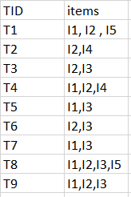
Illustrating Apriori Principle

Slide 15
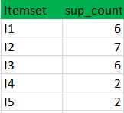
Step1..
K=1 (I) Create a table containing support count of each item present in dataset – Called C1(candidate set)
(II) compare candidate set item’s support count with minimum support count(here min_support=2
if support_count of candidate set items is less than min_support then remove those items).
This gives us itemset L1.

Slide 16
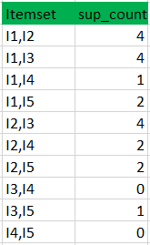
Step2
K=2
Generate candidate set C2 using L1 (this is called join step). Condition of joining L_{k-1} and L_{k-1} is that it should have (K-2) elements in common.
Check all subsets of an itemset are frequent or not and if not frequent remove that itemset.(Example subset of{I1, I2} are {I1}, {I2} they are frequent. Check for each itemset)
Now find support count of these itemsets by searching in dataset

Slide 17
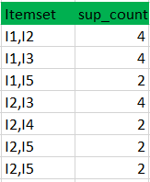
Step2 Contd…
(II) compare candidate (C2) support count with minimum support count(here min_support=2)
if support_count of candidate set item is less than min_support then remove those items) this gives us itemset L2.

Slide 18

Step3
Step-3:
Generate candidate set C3 using L2 (join step). Condition of joining L_{k-1} and L_{k-1} is that it should have (K-2) elements in common. So here, for L2, first element should match.
So itemset generated by joining L2 is {I1, I2, I3}{I1, I2, I5}{I1, I3, i5}{I2, I3, I4}{I2, I4, I5}{I2, I3, I5}
Check if all subsets of these itemsets are frequent or not and if not, then remove that itemset.(Here subset of {I1, I2, I3} are {I1, I2},{I2, I3},{I1, I3} which are frequent. For {I2, I3, I4}, subset {I3, I4} is not frequent so remove it. Similarly check for every itemset)
find support count of these remaining itemset by searching in dataset.

Slide 19
Step3 Contd..
(II) Compare candidate (C3) support count with minimum support count(here min_support=2 if support_count of candidate set item is less than min_support then remove those items) this gives us itemset L3.

Slide 20
Step 4
Step-4:
Generate candidate set C4 using L3 (join step). Condition of joining L_{k-1} and L_{k-1} (K=4) is that, they should have (K-2) elements in common. So here, for L3, first 2 elements (items) should match.
Check all subsets of these itemsets are frequent or not (Here itemset formed by joining L3 is {I1, I2, I3, I5} so its subset contains {I1, I3, I5}, which is not frequent). So no itemset in C4
We stop here because no frequent itemsets are found further

Slide 21
Apriori Property All non empty subsets of a frequent itemset must also be frequent
If a itemset I doesnot satisfy the minimum support threshold, min sup ,then I is not frequent.
If an item a is added to a itemset I, the resulting itemset appear more frequent than I
Antimonotonicity- if a set cannot pass a test, all of its supersets will fall test as well

Slide 22
Apriori Steps
1. The join step: To find find L_{k}, a set of candidate k-itemsets is generated by joining L_{k} with itself. This set of candidates is denoted C_{k}.
2. The prune step: C_{k} is a superset of L_{k} , that is, its members may or may not be frequent, but all of the frequent k-itemsets are included in C_{k}

Slide 23
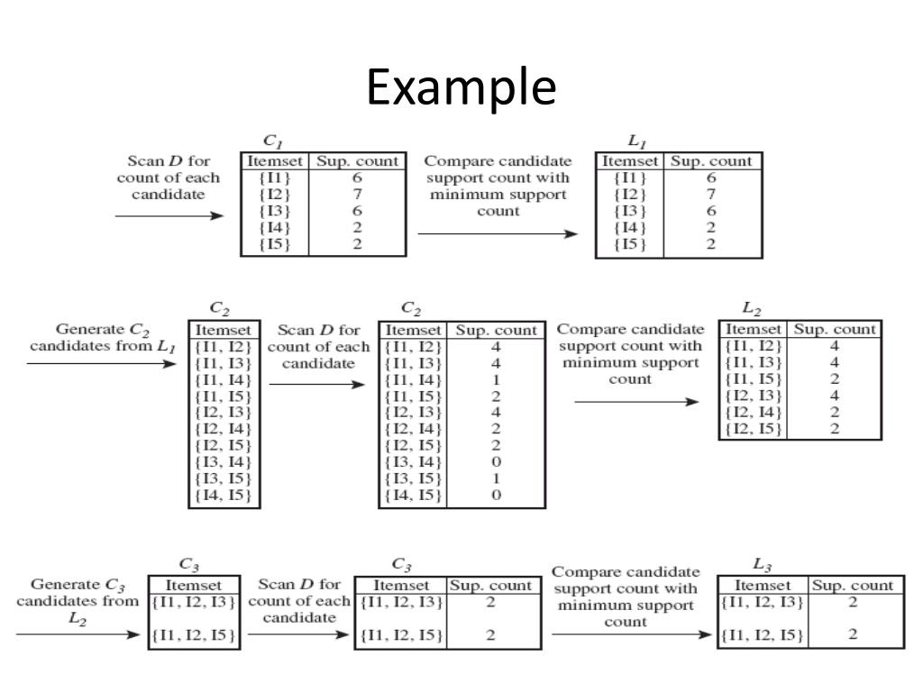

Slide 24
GENERATING ASSOCIATION RULES FROM FREQUENT ITEMSET
Frequent Itemset X= {I1, I2, I3}
Non empty subset of X={ I1, I2, I3, {I1,I2}, {I1,I3}, {I2,I3}}
Confidence(A->B)=Support count(A∪B)/Support_count(A)
I1,I2=>I3 confidence = 2/4=50% I1,I3=>I2 confidence= 2/4=50% [I2,I3]=>[I1] confidence = 2/4=50% [I1]=>[I2, I3] confidence 2/6 =33% [I2]=>[I1,I3] confidence = 2/7=28% [I3]=>[I1,I2] confidence = 2/6 =33%
So if minimum confidence is 50%, then first 3 rules can be considered as strong association rules.

Slide 25
Apriori Algorithm
F_{k}: frequent k-itemsets
L_{k}: candidate k-itemsets
Algorithm
Let k=1
Generate F₁ = {frequent 1-itemsets}
Repeat until F_{k} is empty
Candidate Generation: Generate L_{k+1} from F_{k}
Candidate Pruning: Prune candidate itemsets in L_{k+1} containing subsets of length k that are infrequent
Support Counting: Count the support of each candidate in L_{k+1} by scanning the DB
Candidate Elimination: Eliminate candidates in L_{k+1} that are infrequent, leaving only those that are frequent => F_{k+1}

Slide 26
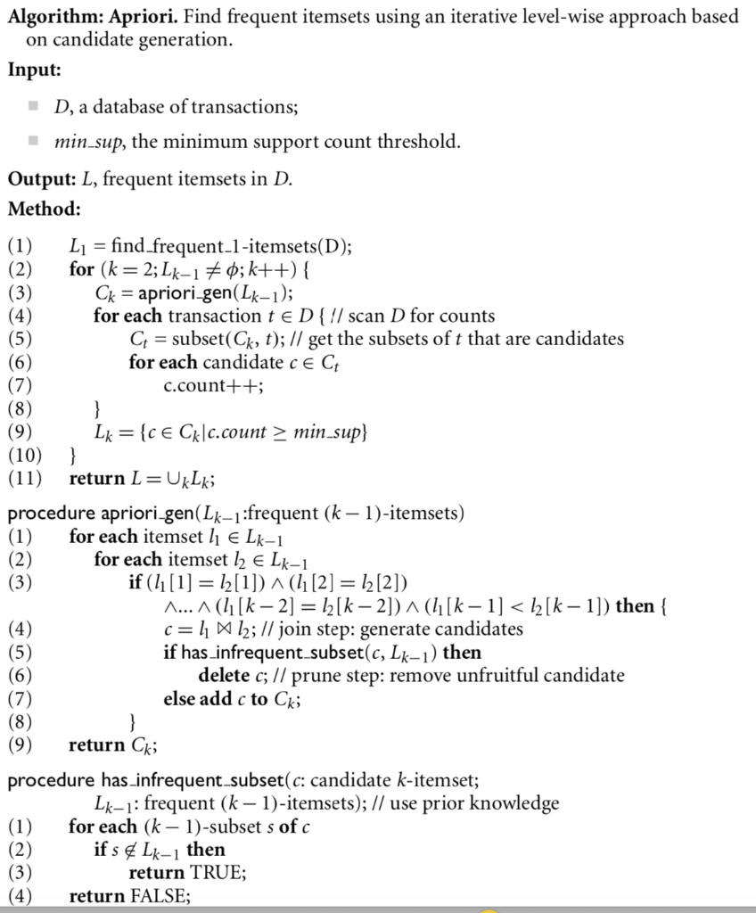

Slide 27
Factors Affecting Complexity of Apriori
Choice of minimum support threshold
Dimensionality (number of items) of the data set
Size of database
Average transaction width

